Slide 1

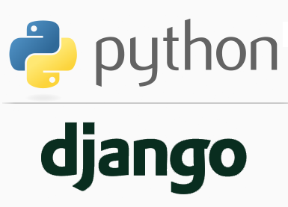
FULL STACK WEB DEVELOPMENT WITH DJANGO
Lecture 21

Slide 2

Today’s Agenda
Developing Our Django App
Database Programming In Django
Using Python’s Database Programming Model In Django
Example

Slide 3
Introduction
In today’s era every website is a database-driven Web site .
A Database Driven Website connects to a database server, retrieves some data out of it, and displays that data on a Web page.

Slide 4
Introduction
They also provide ways for site visitors to populate the database on their own.
A great example is amazon.in, where each product page is essentially a query into Amazon’s product database formatted as HTML, and when a user posts a customer review, it gets inserted into the database of reviews.

Slide 5
Introduction
Django is well suited for making Database-Driven Web sites, because it comes with easy yet powerful tools for performing database queries using Python.
In this part of our Django course we will explore this functionality: Django’s database layer.

Slide 6
The Not-So-Good Way To Access Database
In Django , there is a dumb way to retrieve data from a database in a view.
It’s simple: just use any existing Python library to execute an SQL query and do something with the results.
However it will be a cumbersome approach as all the necessary steps along with writing the SQL query will have to be performed by us.

Slide 7
The Not-So-Good Way To Access Database
To understand all this let us design an app which pulls names and prices of all the books from the database and displays them on the web page.
Assume we have a table called allbooks in our sqlite database having 4 columns called bookid, bookname, bookprice and subject.

Slide 8
Steps Needed
To interact with databases in Django using the conventional way we need to follow below mentioned steps:
Activating Django Environment in VS Code
Creating a Django Project in VS Code
Creating the app
Activating the app
Create the templates directory structure.
Create the HTML file inside the template directory
Creating the view to fetch records from the database and render the template
Configuring the View in Url
Running the server
Opening the page in browser

Slide 9
Steps Needed
As we can observe , all the steps are just like previous apps with only 1 extra step:
Creating the view to fetch records from the database and render the template

Slide 10
Initial Steps
Create a django project called dbproject1 and create the app by the name of dbapp1.
Perform all the basic steps needed to configure the dbapp1 .
Set the url for the view as “books/” in the urls.py of dbapp1
Also create a templates folder containing dbapp1/showbooks.html file

Slide 11
Creating The View
To pull records from the allbooks table in our view we will have to do the following:
Import the package sqlite3
Define a function called bookPageView()
Create a list called bookrecords , a string called errormsg and a dictionary called context
Establish a connection to the database.
Create a cursor to communicate with the data.
Execute the SQL query
Fetch each row returned by the SQL query and store it in the list bookrecords as a dictionary where each dictionary will have a key-value pair.
The keys will be bookname and bookprice and their values will be the value of the respective columns of the row

Slide 12
Creating The View
If no exception arises then store the list bookrecords in the dictionary context as a key called ‘records’ .
Otherwise if an exception occurs then store the string errormsg containing the error details as a key called ‘error’ in the dictionary context.
Finally , render the context dictionary to the template showbooks.html

Slide 13
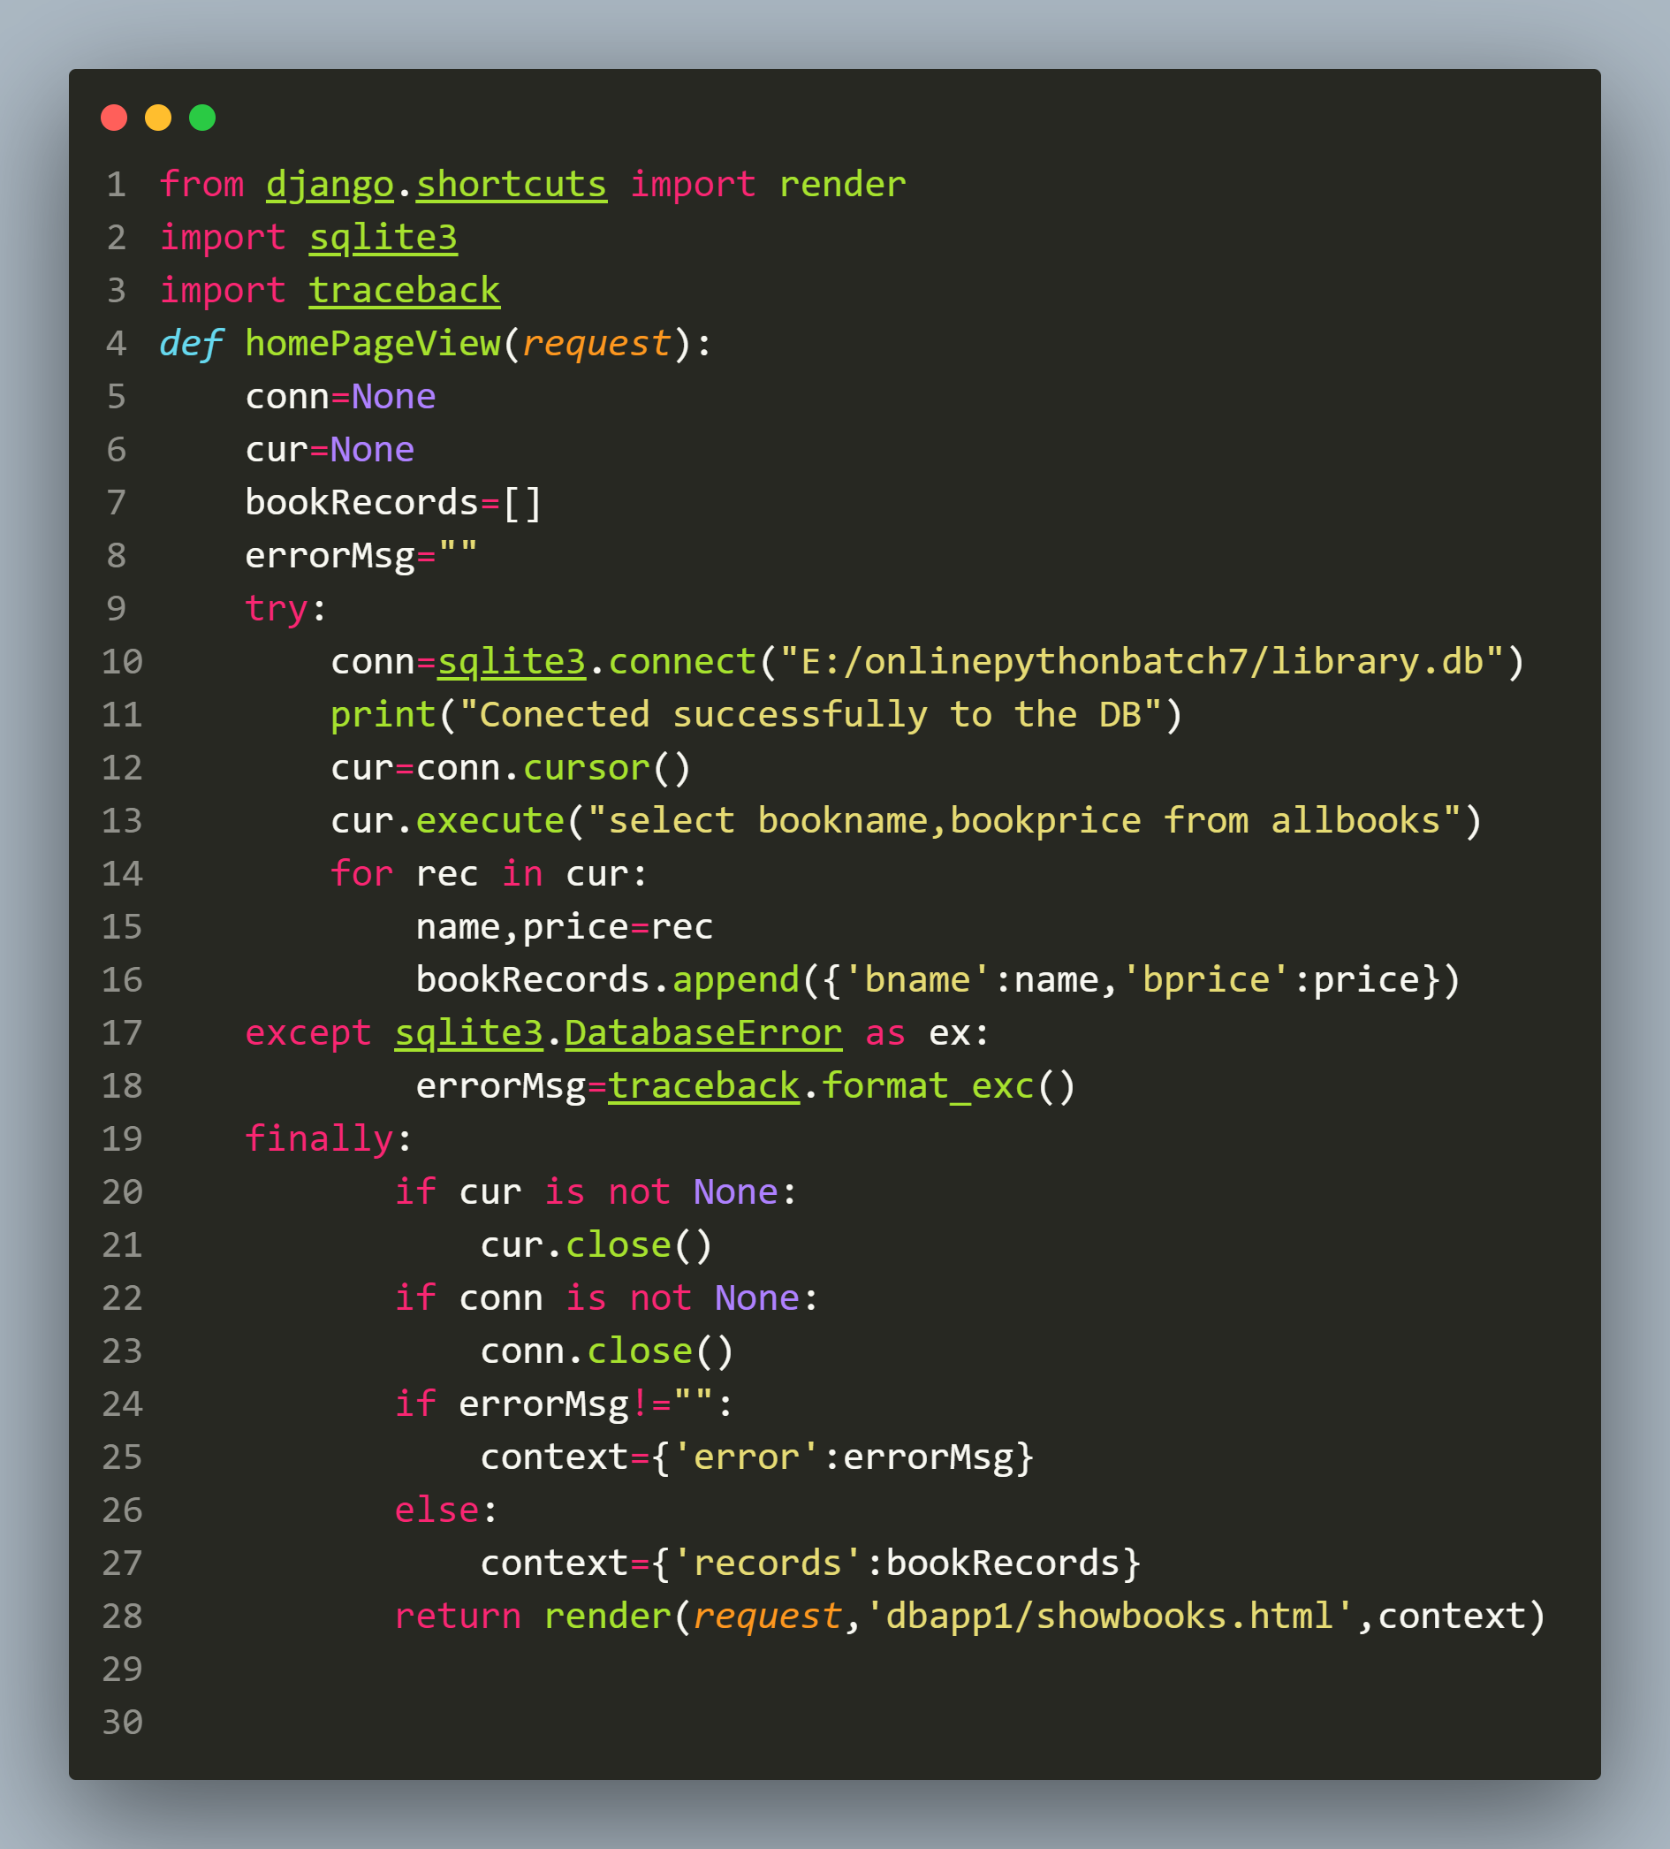
The Code

Slide 14
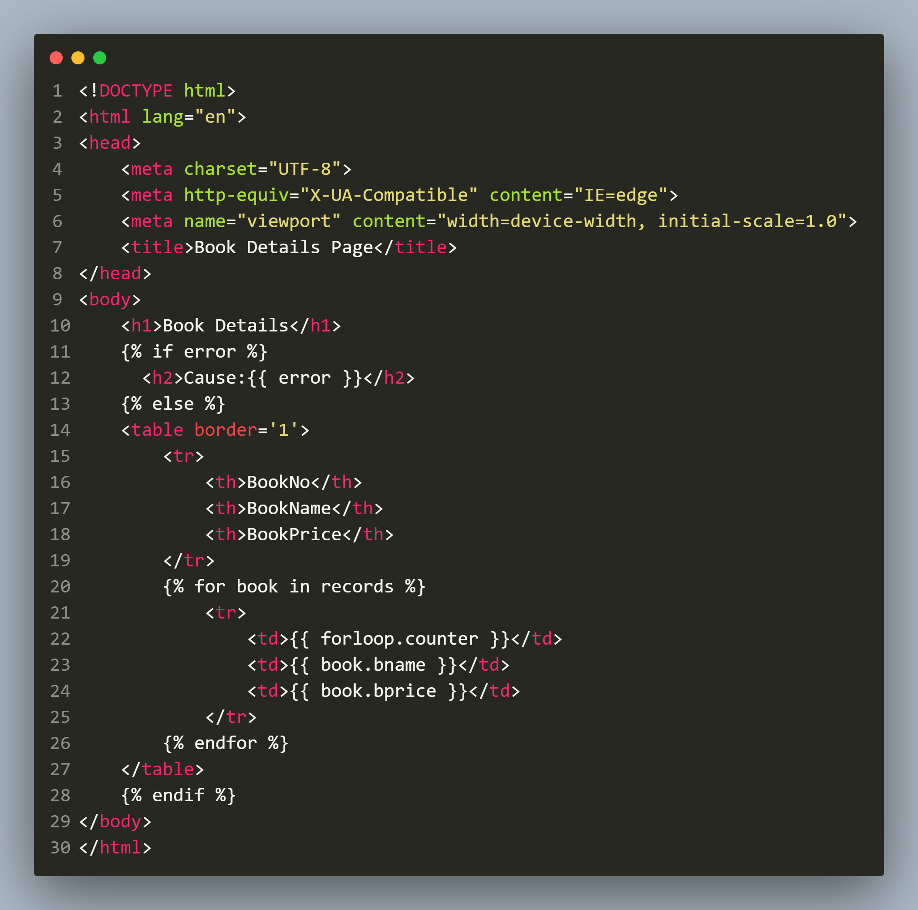
Code In showbooks.html

Slide 15
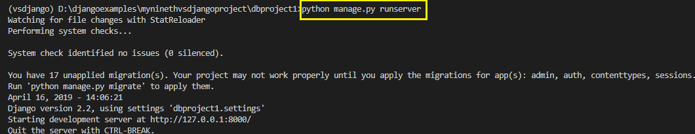
Running The Server
To run the dbapp1 , go to the folder dbproject1 by using cd command and type the runserver command in VS Code terminal
cd dbproject1
python manage.py runserver.
The server runs and we’ll see output like the following output in the terminal window:

Slide 16
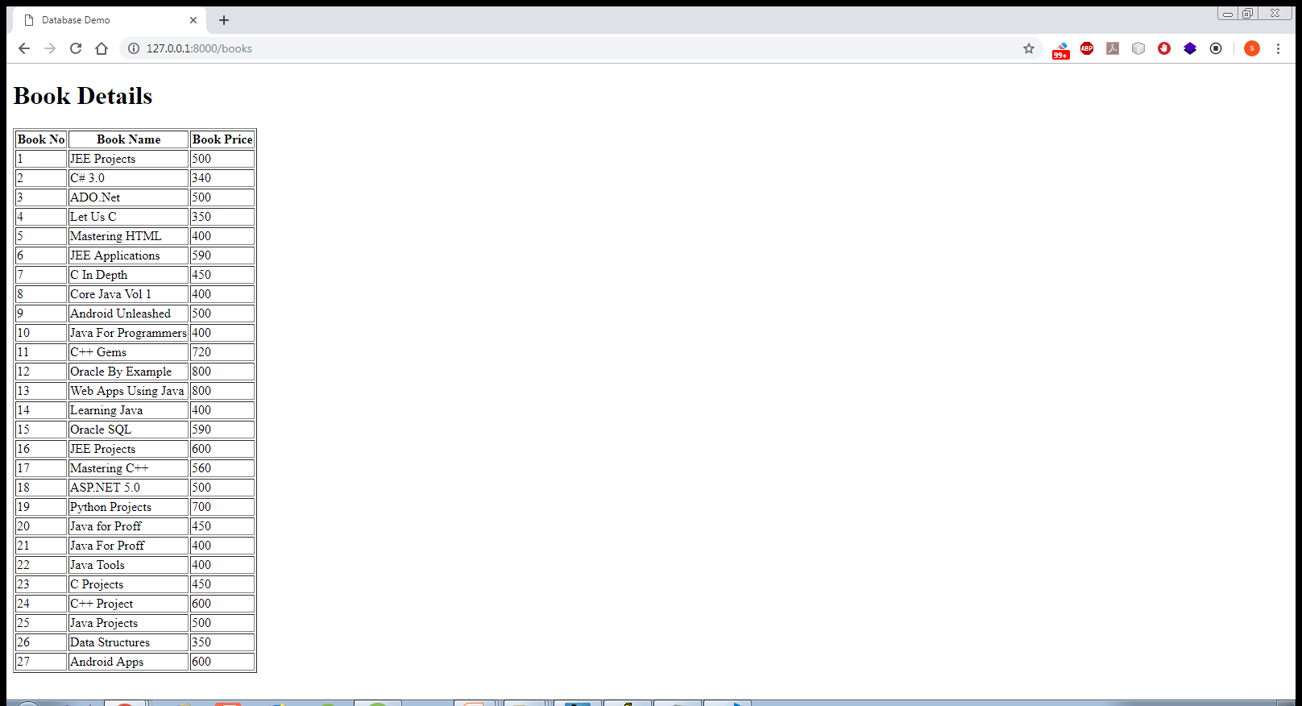
Opening The Page
Open the browser and type the url
http://127.0.0.1:8000/books in the window to open
template page with the records from allbooks table loaded

